Slide 1

Rockbuster Analysis: Business Insights from Data
By Jeremy Obach
Lead Data Analyst

Slide 2
Film Table
Summary Statistics - Numeric | Minimum | Maximum | Average
Rental Duration (days) | 3 | 7 | 4.985
Rental Rate (USD) | .99 | 4.99 | 2.98
Length (minutes) | 46 | 185 | 115.272
Replacement Cost (USD) | 9.99 | 29.99 | 19.98
Release Year | 2006 | 2006 | 2006

Slide 3

Film Table
Most common entries (MODE) by category:
Rating – PG-13 (223)
Language – English (1000)
Special Features – Trailers, Commentaries, “Behind the Scenes”
Year – 2006 (1000)

Slide 4
Actor Table
Most common entries (MODE) by category:
First Name – Julia (4)
Last Name – Kilmer (5)

Slide 5
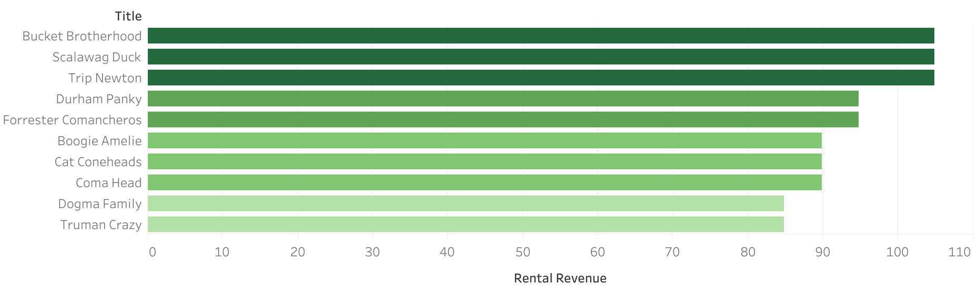
Top 10 films by Rental Revenue

Slide 6
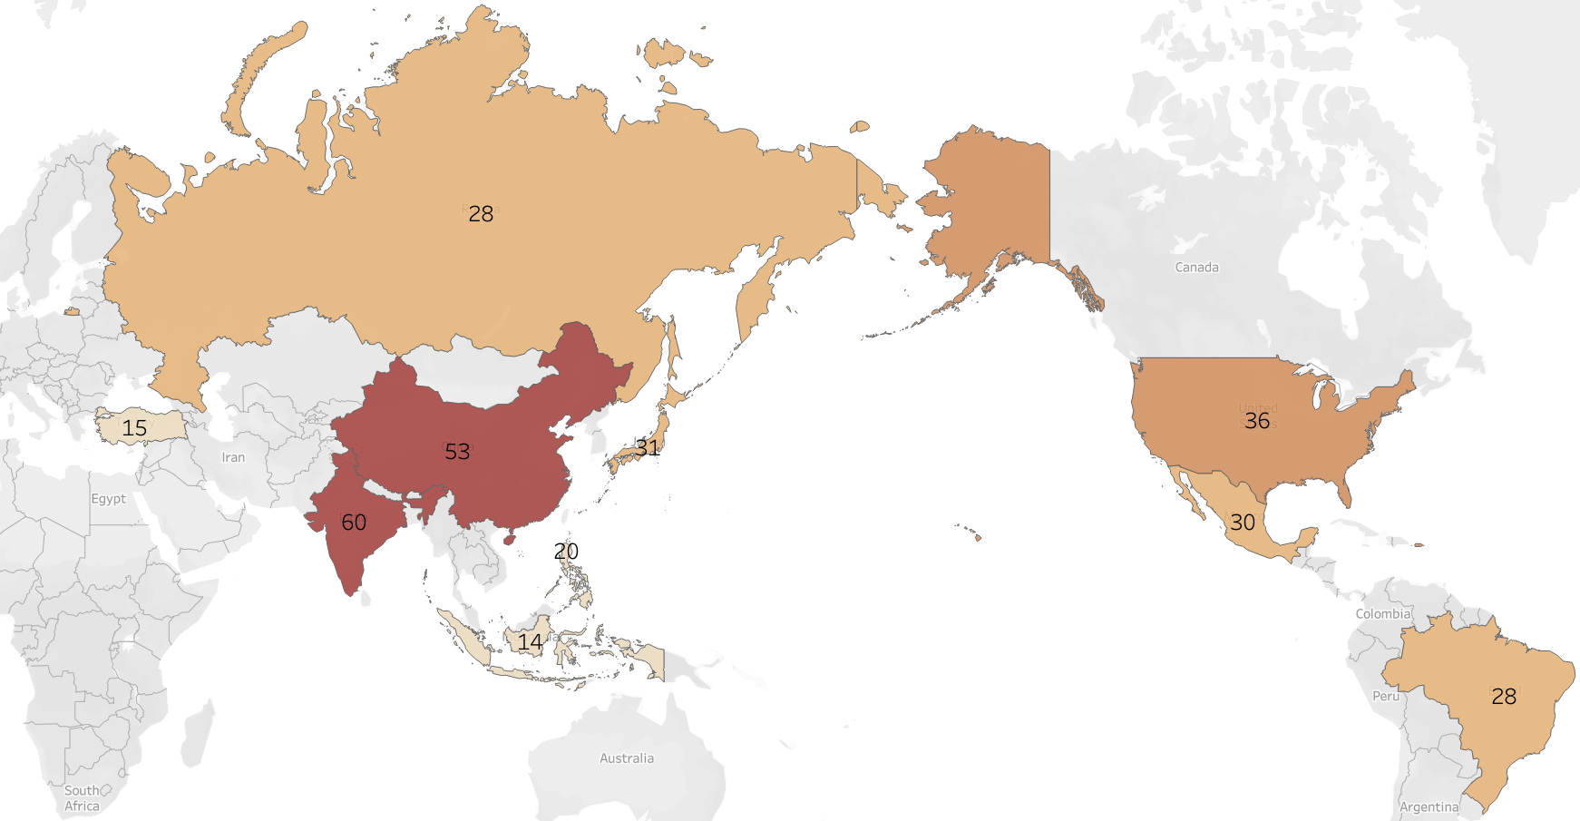
Top 10 Countries by Customer count
India | 60
China | 53
United States | 36
Japan | 31
Mexico | 30
Brazil | 28
Russian Federation | 28
Philippines | 20
Turkey | 15
Indonesia | 14

Slide 7
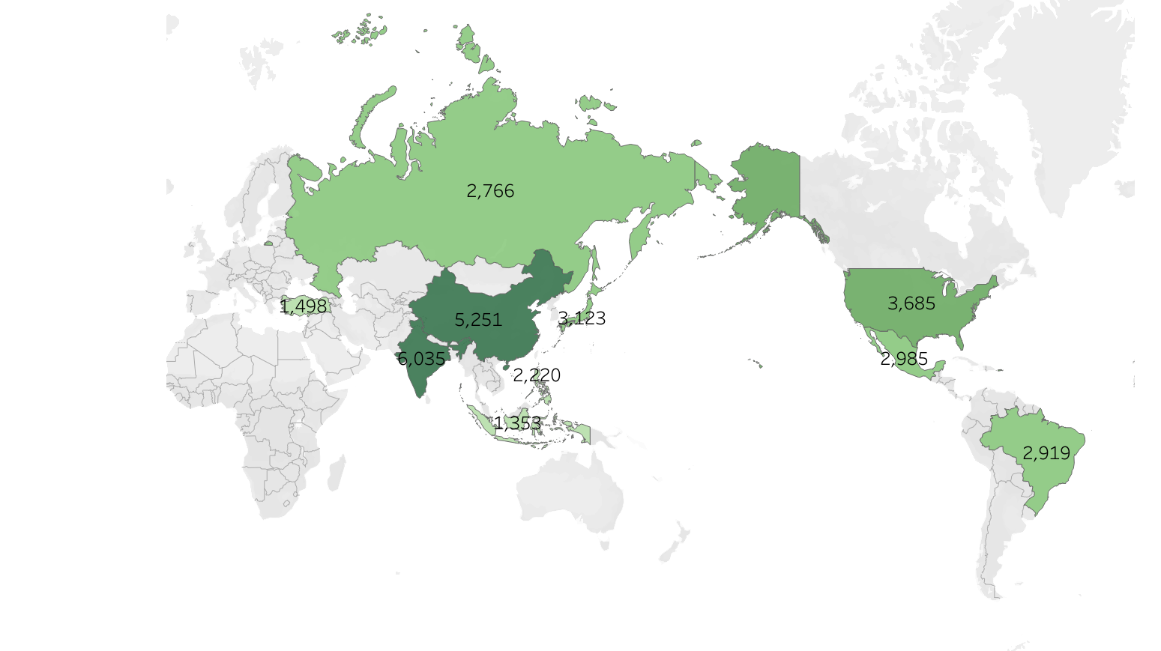
Top 10 Countries by Rental Revenue
India | 6034.78
China | 5251.03
United States | 3685.31
Japan | 3122.51
Mexico | 2984.82
Brazil | 2919.19
Russian Federation | 2765.62
Philippines | 2219.70
Turkey | 1498.49
Indonesia | 1352.69

Slide 8
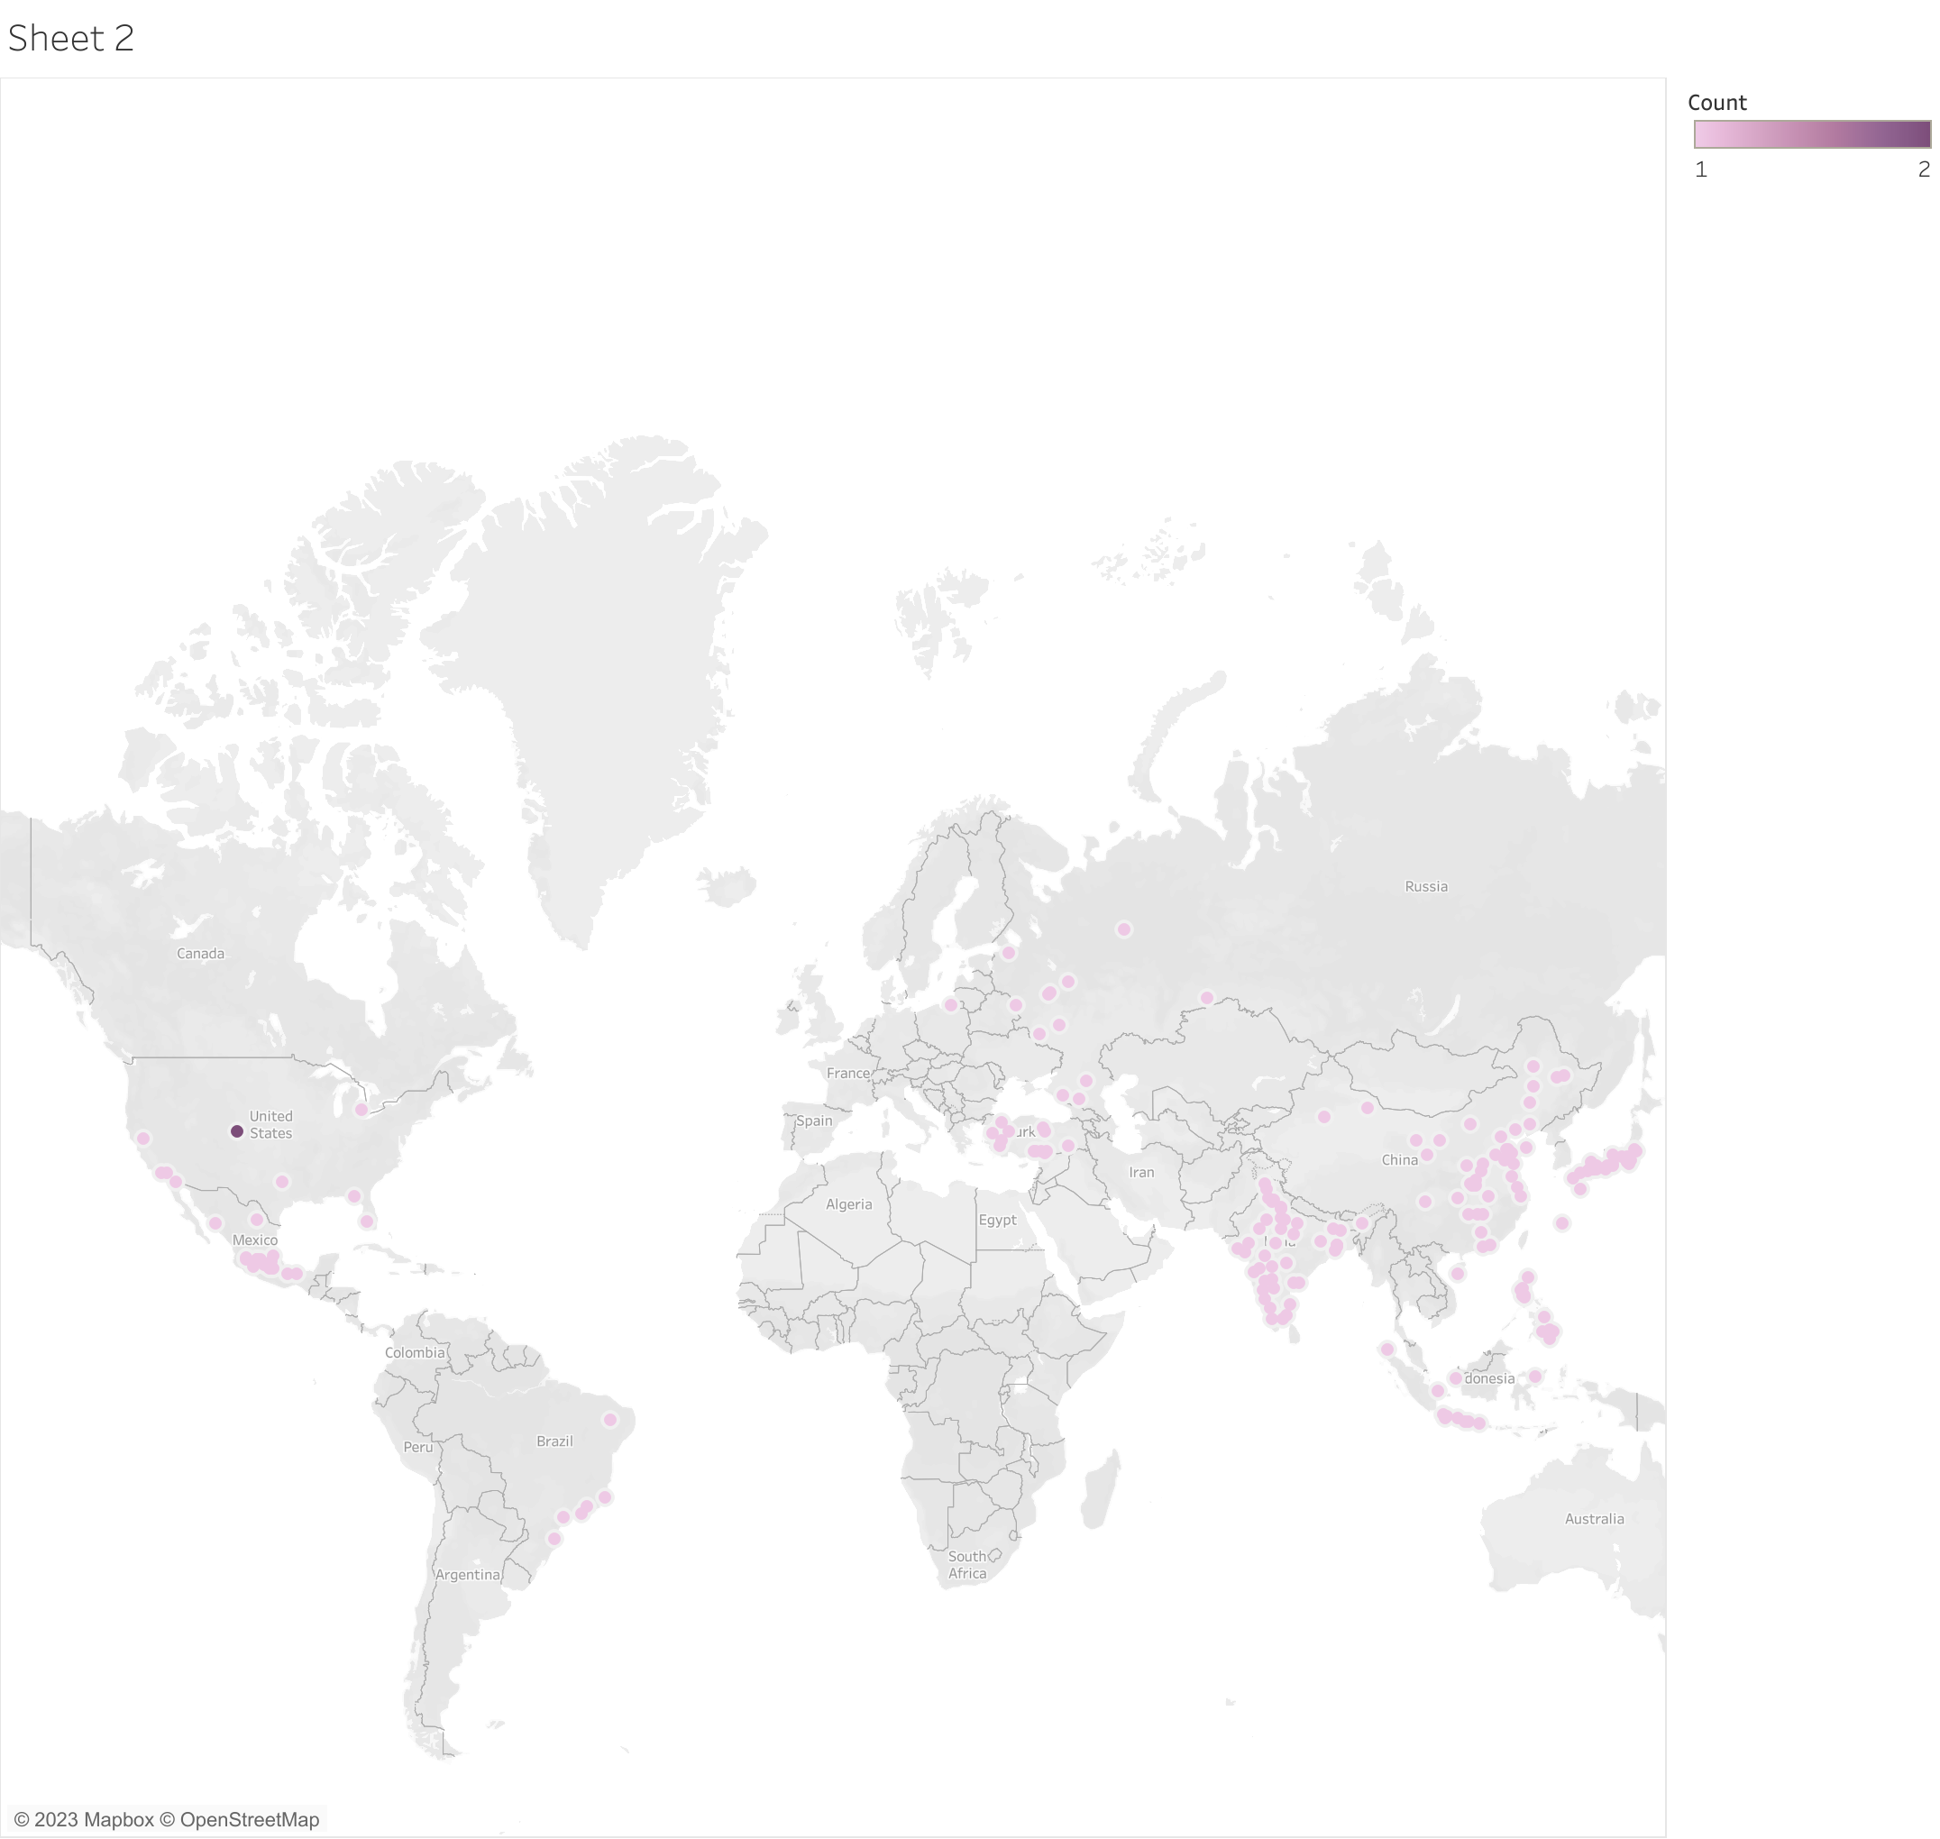
Customer distribution by city
Only one city (Aurora, CO, USA) had more than 1 customer.
Customers resided in 313 other cities.

Slide 9
Top 5 Customers
Name | City | Country | Amount Spent with Rockbuster
Sarah Perry | Atlixco | Mexico | 128.70
Clinton Buford | Aurora | United States | 98.76
Adam Gooch | Adoni | India | 97.80
Bob Pfeiffer | Xintai | China | 82.78
Scott Shelley | Aurora | Unites States | 60.82

Slide 10
Key Insights
Wide distribution of customers
314 different cities, only 1 city with more than 1 customer
2 of the top 5 customers by spend in Aurora, CO.
Top 10 countries by customer count and rental revenue
In the exact same order
Led by India, China, USA
Average rental duration
= ~5 days
Top Revenue earning films:
Bucket Brotherhood, Scalawag Duck, Trip Newton
All 1000 film entries are in English
Most common Rating
PG-13

Slide 11

Tableau Link
https://public.tableau.com/views/RockbusterSubscribers-geospatial/Rockbustercustomercountries

